Slide 1
Real-Time Scheduling Algorithm
RATE MONOTONIC SCHEDULING
12-2069
12-2176

Slide 2
REAL TIME SYSTEMS
_ Systems having correctness depends on their temporal aspects as well as
their functional aspects
_ Predictability on timing constrains
_ Prformance measure depends on timeliness(deadline) and
_ Speed/average case performance

Slide 3
REAL TIME SYSTEMS
Digital control systems periodically performs the following job:
- senses the system status
- actuates the system according to its current status
Multimedia application periodically performs the following job:
- reads, decompresses, and displays video and audio streams

Slide 4
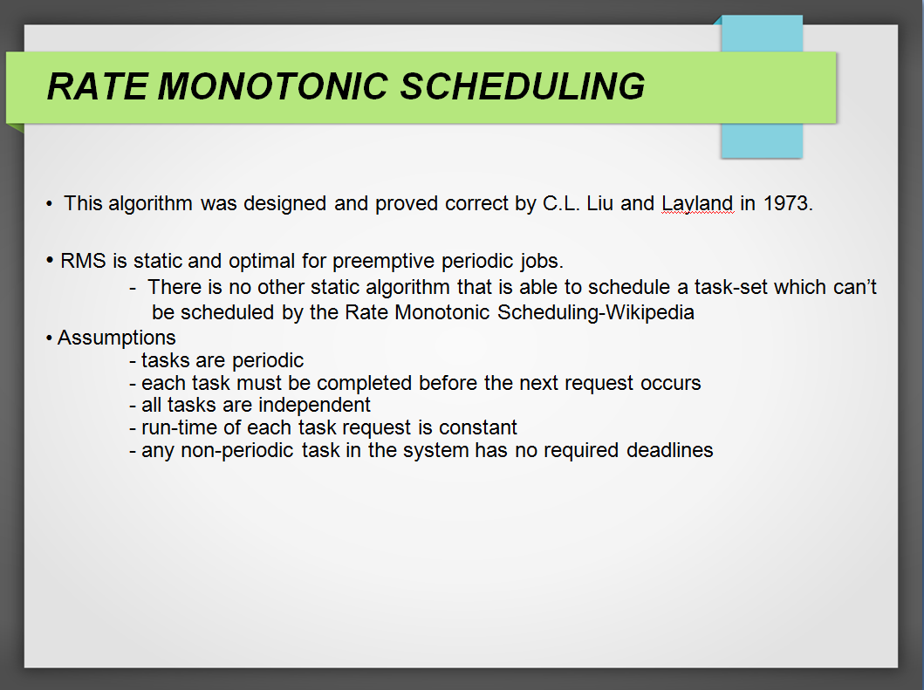
RATE MONOTONIC SCHEDULING
This algorithm was designed and proved correct by C.L. Liu and Layland in 1973.
RMS is static and optimal for preemptive periodic jobs.
- There is no other static algorithm that is able to schedule a task-set which can’t
be scheduled by the Rate Monotonic Scheduling-Wikipedia
Assumptions
- tasks are periodic
- each task must be completed before the next request occurs
- all tasks are independent
- run-time of each task request is constant
- any non-periodic task in the system has no required deadlines

Slide 5
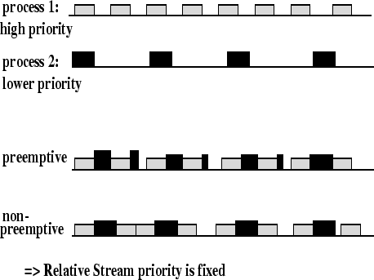
RATE MONOTONIC SCHEDULING
Process priority = task frequency
Higher priority process preempts lower priority process

Slide 6
RATE MONOTONIC SCHEDULING
Optimal static-priority scheduling
Assigns priority according to period
A task with a shorter period has a higher priority
Executes a job with the shortest period
Simpler implementation, even in systems without explicit support
for timing constraints
Predictability for the highest priority tasks

Slide 7
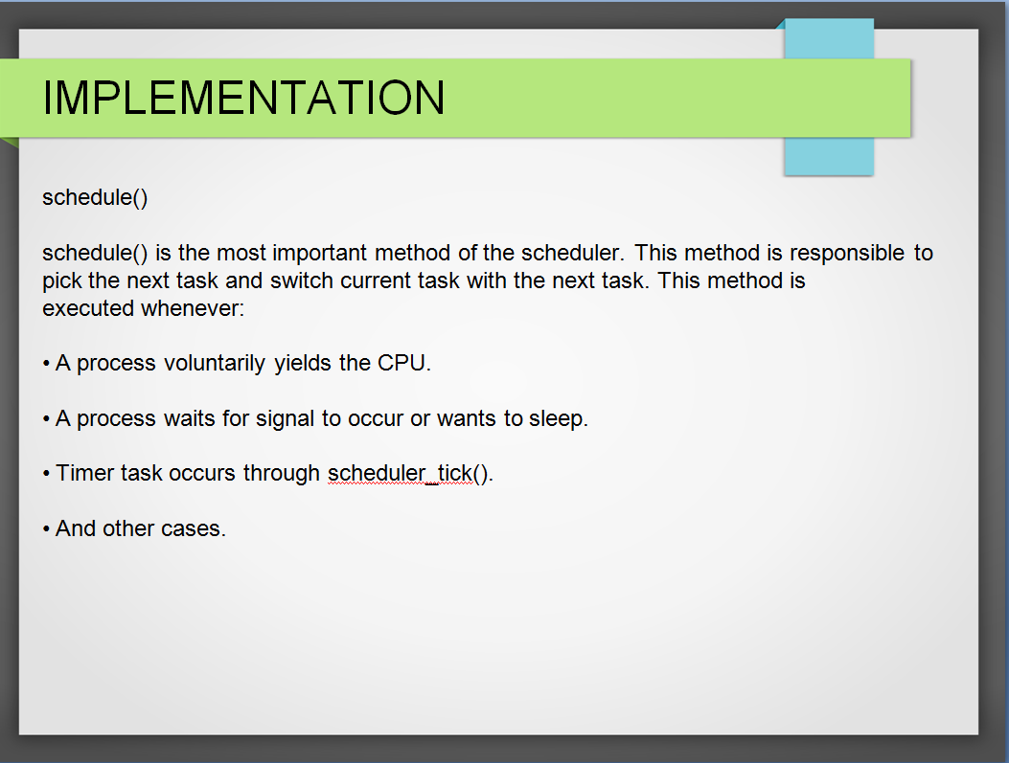
IMPLEMENTATION
schedule()
schedule() is the most important method of the scheduler. This method is responsible to
pick the next task and switch current task with the next task. This method is
executed whenever:
A process voluntarily yields the CPU.
A process waits for signal to occur or wants to sleep.
Timer task occurs through scheduler_tick().
And other cases.

Slide 8
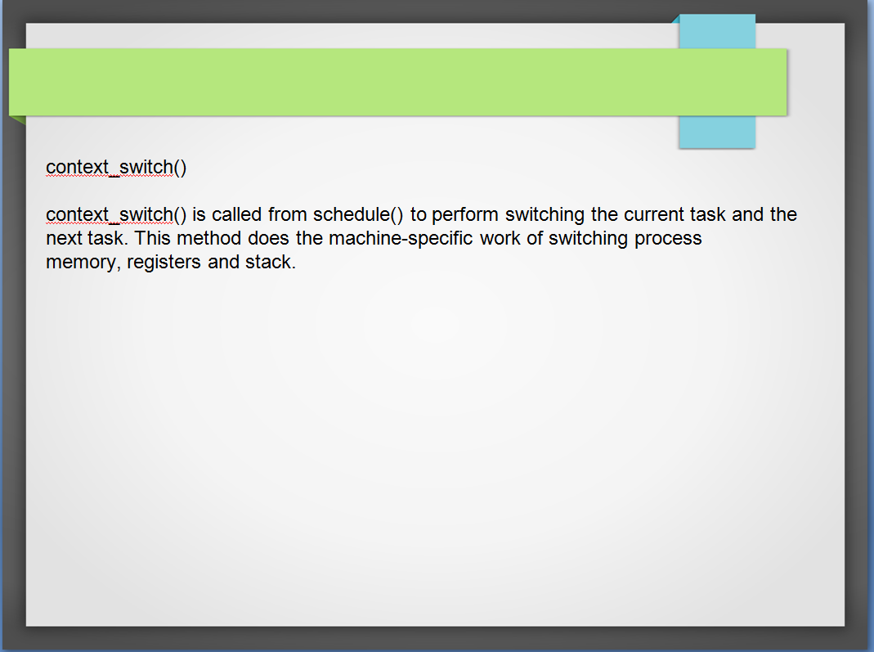
context_switch()
context_switch() is called from schedule() to perform switching the current task and the
next task. This method does the machine-specific work of switching process
memory, registers and stack.

Slide 9
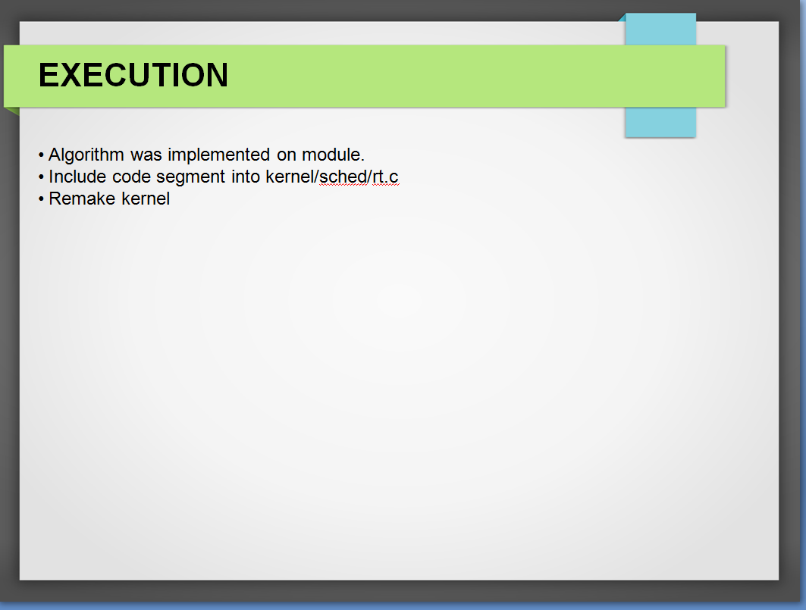
EXECUTION
Algorithm was implemented on module.
Include code segment into kernel/sched/rt.c
Remake kernel

Slide 10

THANK YOU
Habibullah Rafay 12-2176
Muhammad Omer Haqqani 12-2069

